Slide 2
Chapter 9.
Developing SmartThings IoT Device through
Galaxy Upcycling
IoT Course

Slide 3
Chapter Description
Chapter Objectives
Learn about Galaxy Upcycling and how to repurpose old devices into much-needed IoT services.
Chapter Contents
Unit 1. Galaxy Upcycling: Introduction
Unit 2. Galaxy Upcycling: How-to (Basic Level)
Unit 3. SmartThings Device SDK to Control MCU (Advanced Level)
Unit 4. Final Configuration and Test: Smart Bulb

Slide 4
Unit 1.
Galaxy Upcycling: Introduction
1.1. Introduction to Galaxy Upcycling
1.2. Objective & Overall Structure of S/W and H/W Architectures

Slide 5
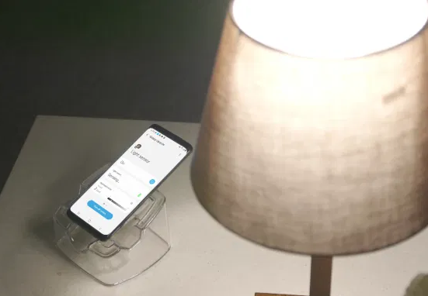
1.1. Introduction to Galaxy Upcycling
UNIT 01
The initiative promotes upcycling old electronics as a creative solution to combat electronic waste and provides convenience for consumers in everyday life.
With Galaxy Upcycling at Home, users can easily turn their old Galaxy devices into smart home devices like a childcare monitor, a pet care solution and other tools that meet individual lifestyle needs.
Users can transform their old devices through SmartThings Labs, a feature within the SmartThings app.

Slide 6
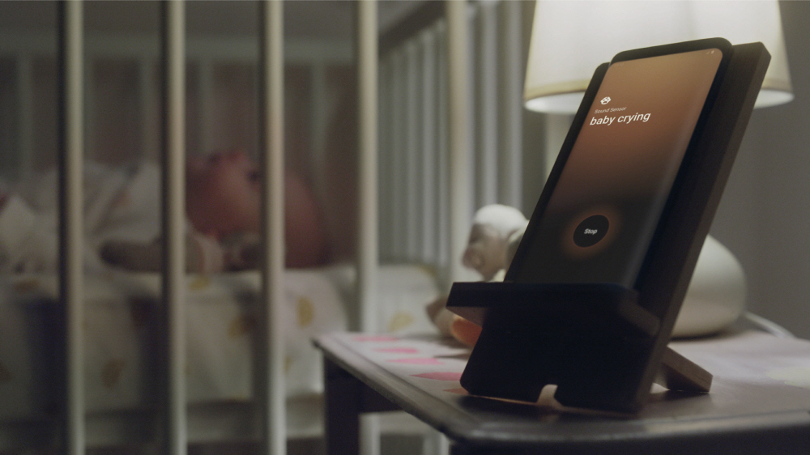
1.1. Introduction to Galaxy Upcycling
UNIT 01
This innovative solution is part of Samsung’s continued commitment to support the 2030 Agenda for Sustainable Development, a global blueprint for the world to achieve a more sustainable and prosperous future for all by 2030 through 17 Sustainable Development Goals. Galaxy Upcycling at Home specifically focuses on Goal 12 – Responsible Consumption and Production – by reducing waste and promoting more sustainable production practices and consumer behaviors.

Slide 7
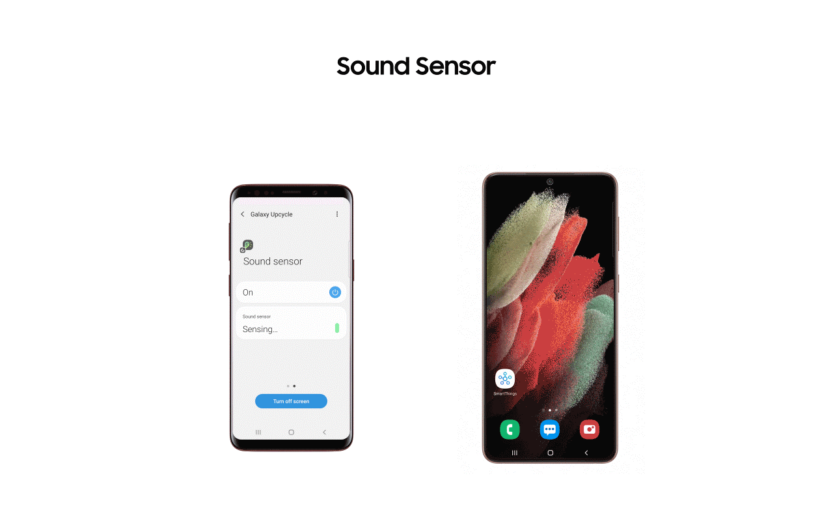
1.1. Introduction to Galaxy Upcycling
UNIT 01
Notes:
[Key Message]
For a device to continuously detect sound and light, it needs to be actively operating for long periods of time. For this reason, Samsung equipped the Galaxy Upcycling at Home upgrade with battery optimization solutions to minimize battery usage. Devices will also be able to connect effortlessly to SmartThings, allowing them to interact with countless other IoT devices in the SmartThings ecosystem.

Slide 8
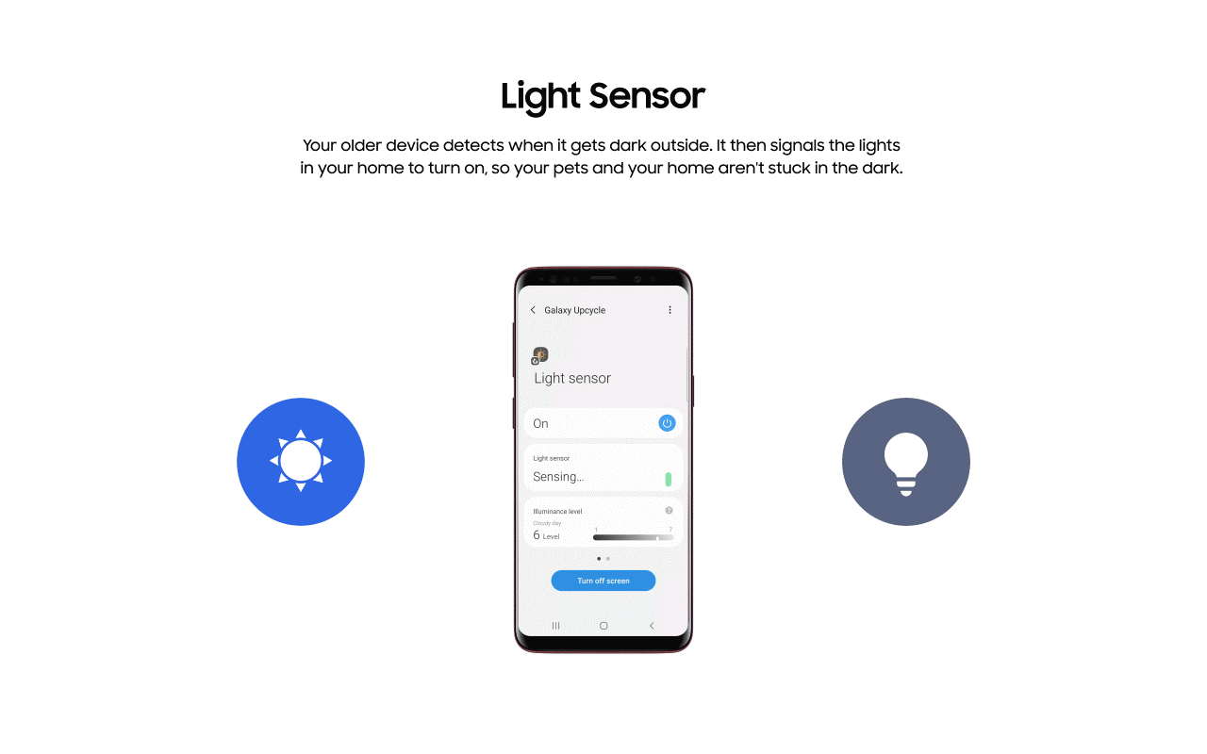
1.1. Introduction to Galaxy Upcycling
UNIT 01

Slide 9
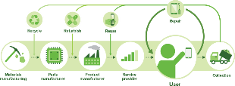

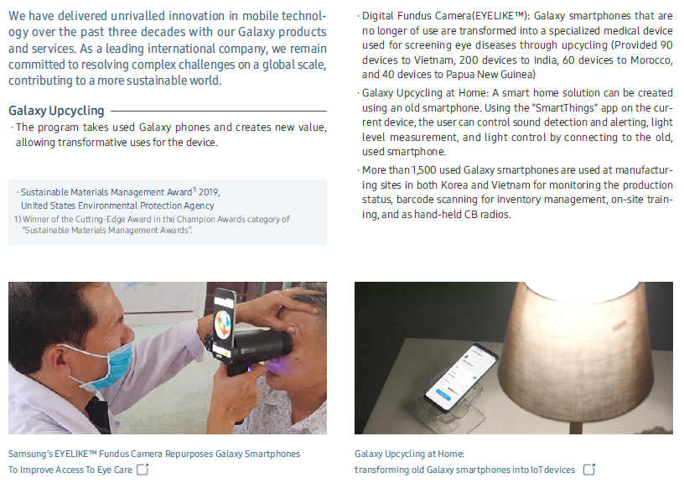

1.1. Introduction to Galaxy Upcycling
UNIT 01
Galaxy Upcycling is an eco-circulation program that repurposes existing resources into a new efficient use.
It is a more value-added approach than recycling as it can extend a product’s life cycle and reduce opportunity costs of manufacturing new products.
Upcycle
2018, 2020 (USA, EPA)
SMM EPA Award, Champion – Cutting Edge
2018. 5 (USA, Judges’ Choice)
Environmental Leader – Project of the year
2018~ 2020
Samsung Sustainability Report

Slide 10

1.1. Introduction to Galaxy Upcycling
UNIT 01
Galaxy Upcycling at Home is recognized at the Reuters Responsible Business Awards
Judges noted that Samsung’s upcycling solution is “A simple initiative with a basic idea, which helps shift the mindset on the value of old phones. A genuine closed loop versus recycling of e-waste with an innovative twist.”
2021. 10 (USA, Reuters Events: Responsible Business 2021)
Highly Commended – Circular Transition Award
Notes:
Link : https://news.samsung.com/us/samsung-electronics-galaxy-upcycling-at-home-program-recognized-at-the-reuters-responsible-business-awards/

Slide 11
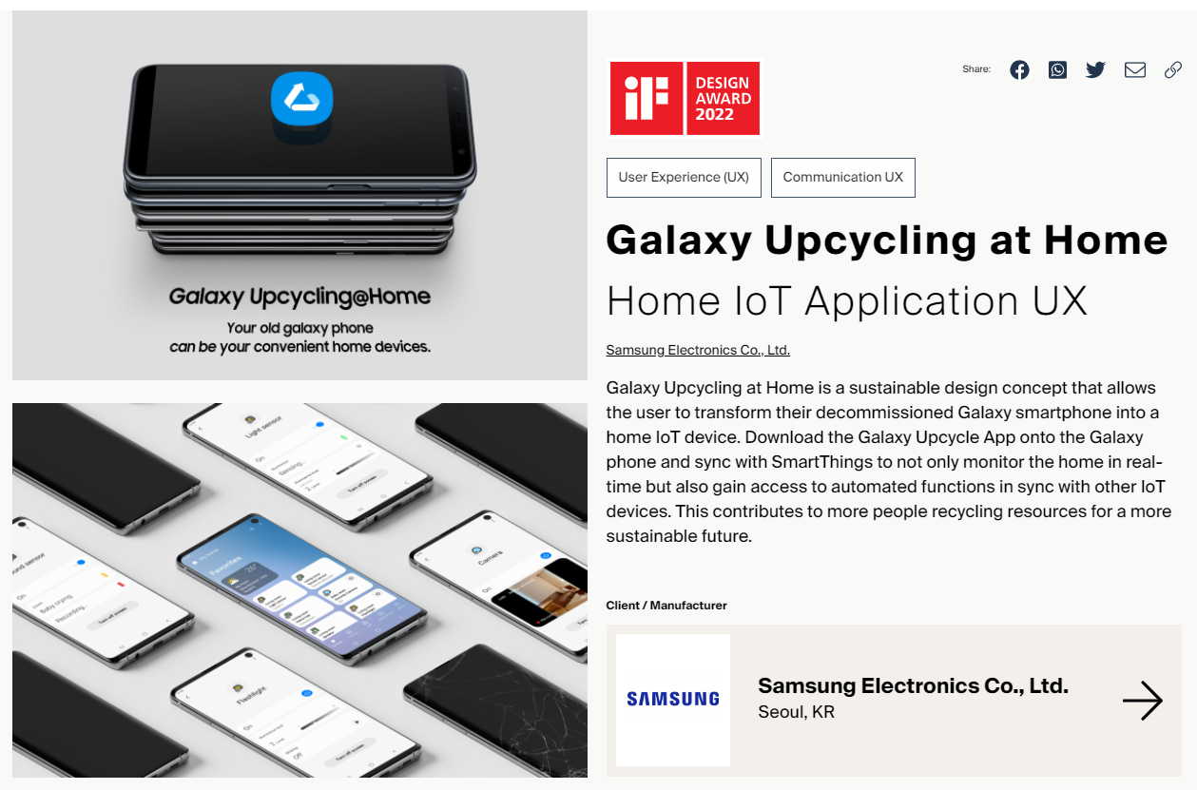
1.1. Introduction to Galaxy Upcycling
UNIT 01
Galaxy Upcycling at Home is recognized at 2022 iF Design Award
Notes:
Link : https://ifdesign.com/en/winner-ranking/project/galaxy-upcycling-at-home/345103

Slide 12
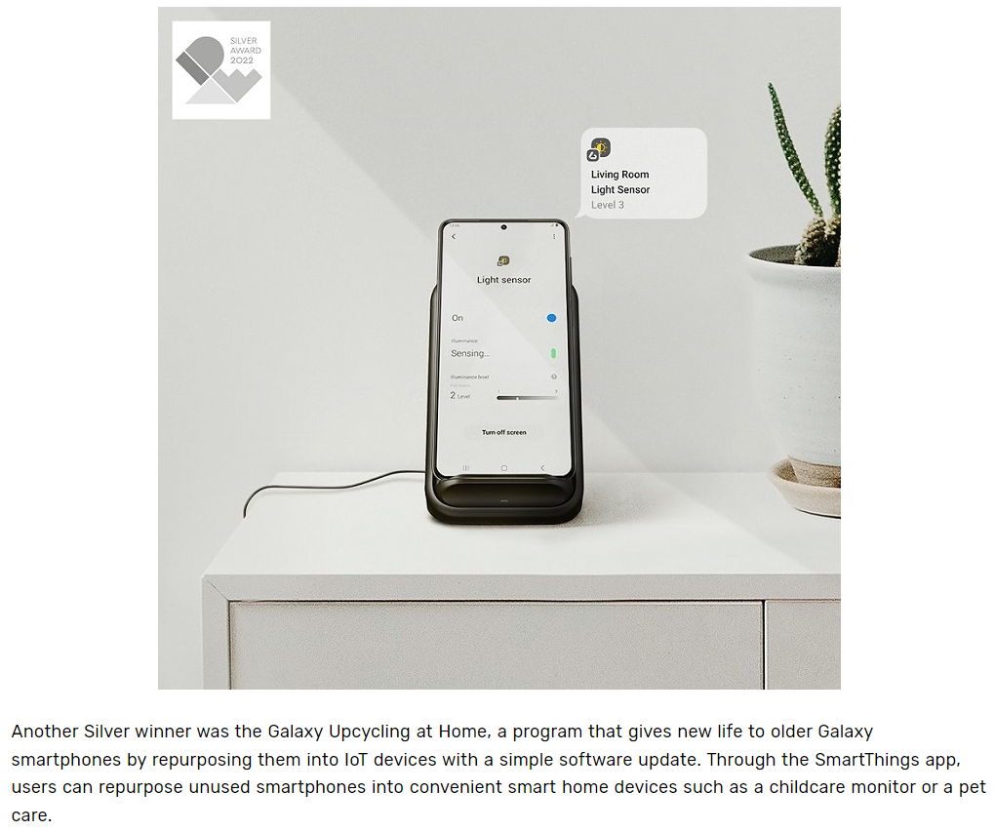
1.1. Introduction to Galaxy Upcycling
UNIT 01
Galaxy Upcycling at Home is recognized at 2022 IDEA Silver Award
Notes:
Samsung Newsroom Link : https://news.samsung.com/global/samsung-electronics-wins-42-awards-at-the-international-design-excellence-awards-2022
IDEA 2022 Link : https://www.idsa.org/awards/idea/digital-interaction/upcycling-smartphone-home
Samsung Design Instagram Link : https://www.instagram.com/p/CihRS-BJFyq/?igshid=NjQxMzA2Mjk=
[Instructor Guide]
For better understanding, please show 1 min clip (05_04_upcycling_idea_0906_Square1min.mp4) to students

Slide 13
1.1. Introduction to Galaxy Upcycling
UNIT 01
Galaxy Upcycling aims to build a circular economy by reusing.
In this chapter, you can make real-life IoT technology with Galaxy Upcycle app and SmartThings Platform.

Slide 14
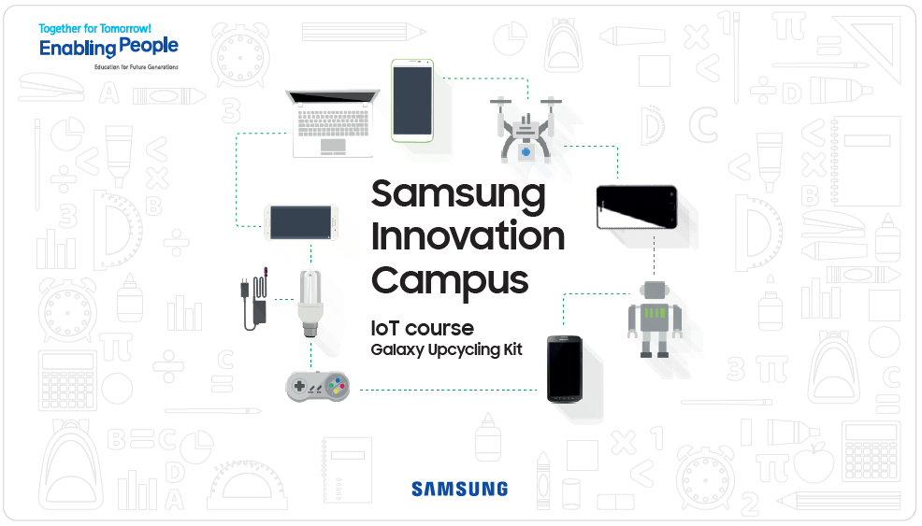

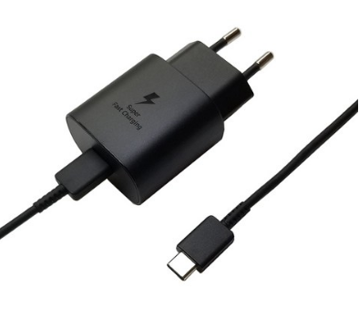
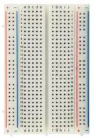
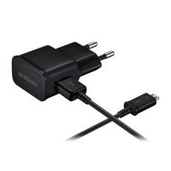
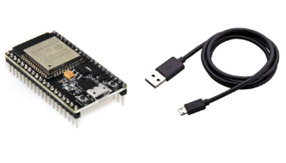
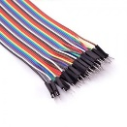
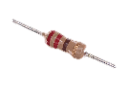
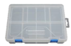
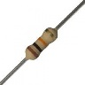
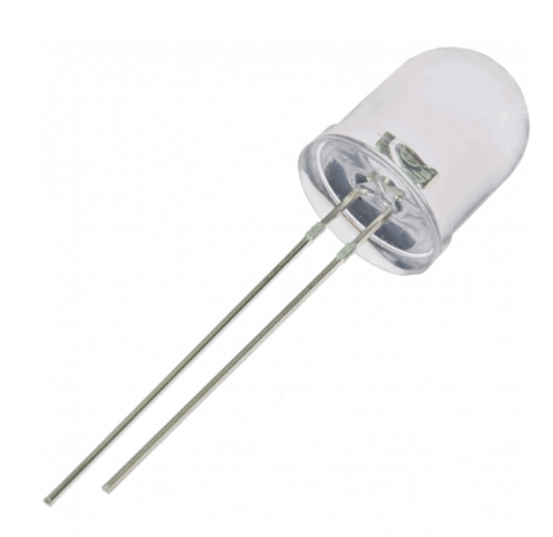
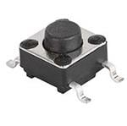


1.2. Objective & Overall Structure of S/W and H/W Architectures
UNIT 01
Materials needed for Galaxy Upcycling
Old Galaxy (S9 or Note9) 1ea
USB Type-C Adapter & Cable
(Charging for old Galaxy)
1ea
ESP32 Dev board & Micro 5p Cable
1ea
Breadboard (400points)
1ea
Micro 5p USB Adapter (Power supply to ESP32)
1ea
Galaxy Upcycling Kit
Sample Image
Jumper Cable M-M
(10P 20cm)
1set
Resistors
(220ohm, 10kohm)
2ea
LED (5pi, Milky white)
1ea
Tactile Switch
1ea
Organizer Box
1ea
If students want to develop a program using the Galaxy Upcycling kit even after Chapter 9 learning is over, the Galaxy Upcycling Kits are available until the IoT course is over. Students can implement their projects using the Galaxy Upcycling Kit when proceeding with the Capstone Project.
It will be a good portfolio if students open their projects on famous global maker websites such as hackster.io and instructables. Please refer to the link. If you have such a case, please share it with CCO.
References
[Instructables: Xmas Decor] https://me2.kr/zgyhb
[Hackster.io: Fish tank lighting upcycle] https://me2.kr/95vej
Notes:
[Instructor Guide]
[Key Message]

Slide 15

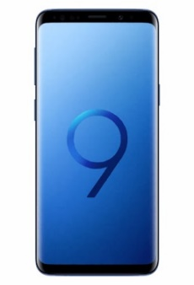

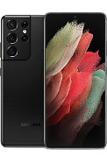
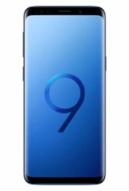
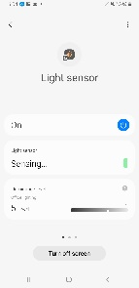
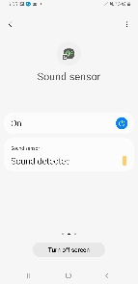
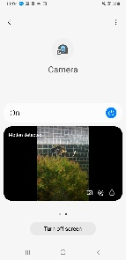
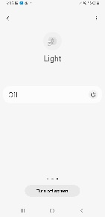
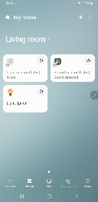
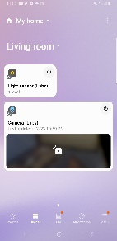
1.2. Objective & Overall Structure of S/W and H/W Architectures
UNIT 02
Repurpose an old Galaxy device through built-in sensors (a light sensor, a sound sensor, a camera, etc.) and control it via SmartThings App
Light sensor
Sound sensor
Camera
Flashlight
Light sensor card
Sound sensor card
Camera card
Flashlight card
Old Galaxy
Smart Home Device by
Galaxy Upcycle app
Device Cards in
SmartThings app
Notes:
[Instructor Guide]
This example is to show how old Galaxy can be transformed easily to IoT thing devices (i.e. Light sensor, Sound sensor, Camera and Flashlight). By familiar Android app installation experience, students can practice general IoT control/event flow and routine together.
[Key Message]
This process is basic course without any programming requirements. So students can learn concept/definition/architecture of IoT thing infra based on Galaxy Upcycling and SmartThings Platform. After the process is completed, students can check 4 operations with commercial IoT environment.
Light sensor to detect brightness (7 level – Night, Twilight, Low indoor lighting, Moderate indoor lighting, Office lighting, Cloudy day, Daylight)
Sound sensor to detect sound source (Baby crying, Dog barking, Cat meowing, Glass breaking, Knock on door, Siren, Finger snapping, Snoring)
Camera to detect video (auto recording via motion and sound)
Flashlight to brighten place (on/off by routine)

Slide 16
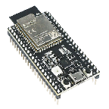
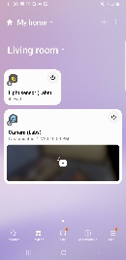
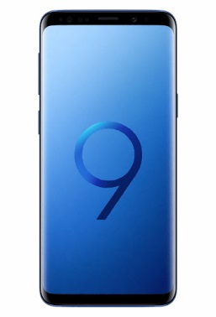
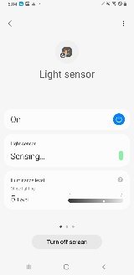
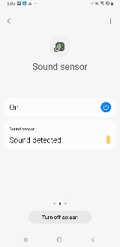
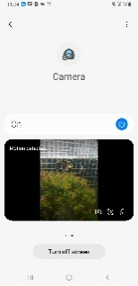
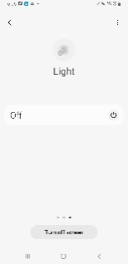
1.2 Overall Structure of S/W and H/W Architectures
UNIT 02
Smart Things
MCU
(ESP32)
Internet
MQTT
Internet
Internet
Protocol
WebRTC
Internet
Using Galaxy with
SmartThings app
Old Galaxy with
Galaxy Upcycle app
Notes:
[Instructor Guide]
The architecture is a common process required to work in a typical commercial IOT cloud. This advance course allows students to understand the overall structure of a commercial Home IoT cloud and to experience the protocols like MQTT required by the IoT.
[Key Message]
The overall architectural configuration for connecting LEDs connected to MCU to SmartThings is shown above. MCU's GPIO is controlled by STDK firmware. The state of the LED is registered and managed as an IoT device in SmartThings Cloud and SmartThings App.

Slide 17
1.2 Overall Structure of S/W and H/W Architectures
UNIT 02
Complete each part which will produce upcycled device altogether
Part 3
Part 3
Part 4
Smart Things
MCU
(ESP32)
Internet
MQTT
Part 2
Internet
Internet
Protocol
Part 1
WebRTC
Internet
Using Galaxy with
SmartThings app
Old Galaxy with
Galaxy Upcycle app
Notes:
[Instructor Guide]
[Key Message]
Since various components are connected to each other, we will divide the practices into 4 areas as above and connect each result for the final operation.

Slide 18
Unit 2.
Galaxy Upcycling: How-to (Basic Level)
2.1. Installing Galaxy Upcycle App
2.2. Adding SmartThings IoT Devices
2.3. Controlling IoT
Notes:
[Instructor Guide]
[Key Message]
In this lesson, we will take a quick look at Galaxy Upcycle app and control IoT things on old Galaxy.

Slide 19
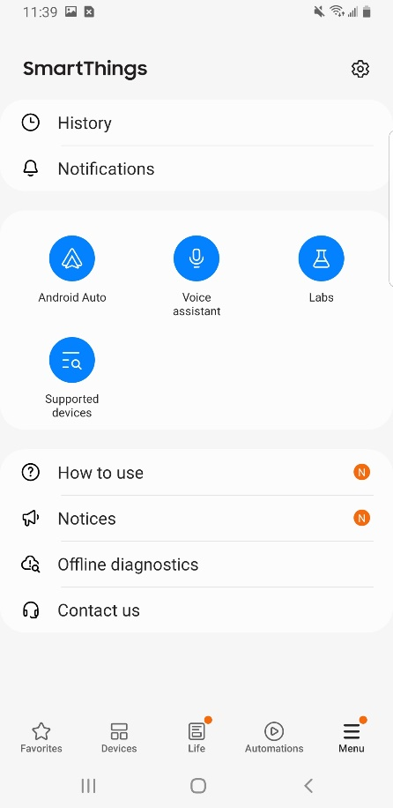
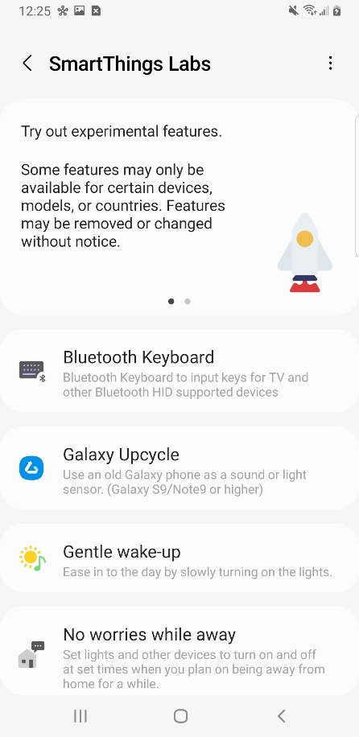
2.1. Installing Galaxy Upcycle App
UNIT 02
Install Galaxy Upcycle app in Old Galaxy (Click Labs in SmartThings app)
①
Process
① SmartThings app
② Labs
③ Galaxy Upcycle
②
③
The Labs feature of Galaxy Upcycle is available in South Korea, USA and UK. In case of other countries, the installation is available only for educational purposes like SIC.
Notes:
[Instructor Guide]
Galaxy Upcycle menu is only shown to South Korea, USA and UK (i.e. Based on country of Samsung Account). So if your country is not matched with the condition, students can install Galaxy Upcycle app via QR code image in p.18.
[Key Message]

Slide 20
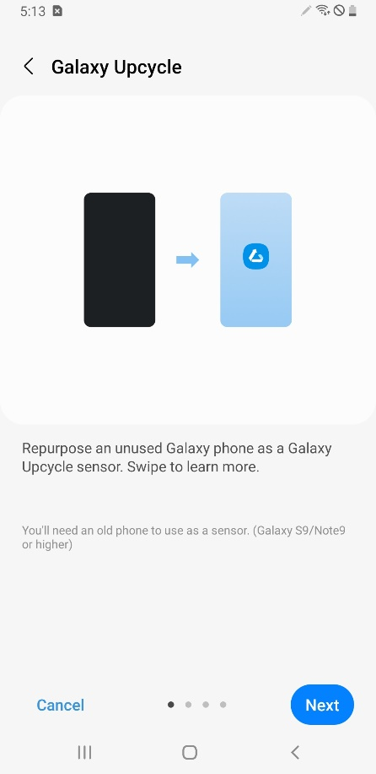
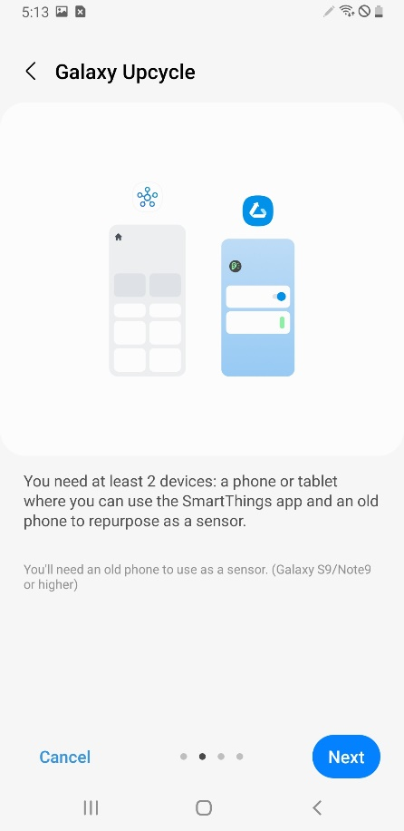
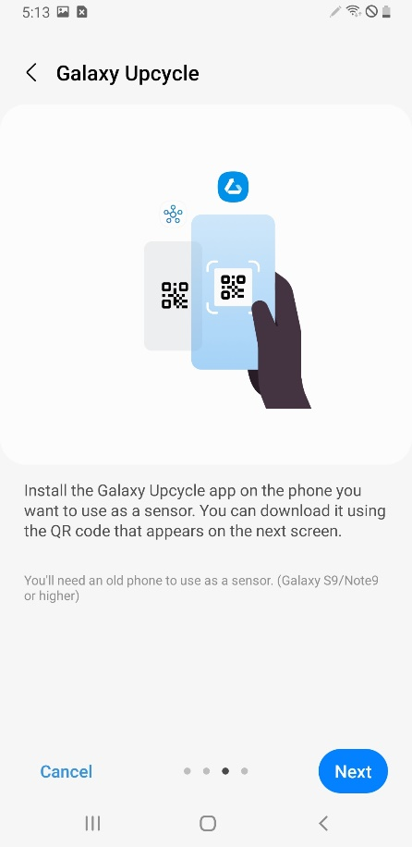
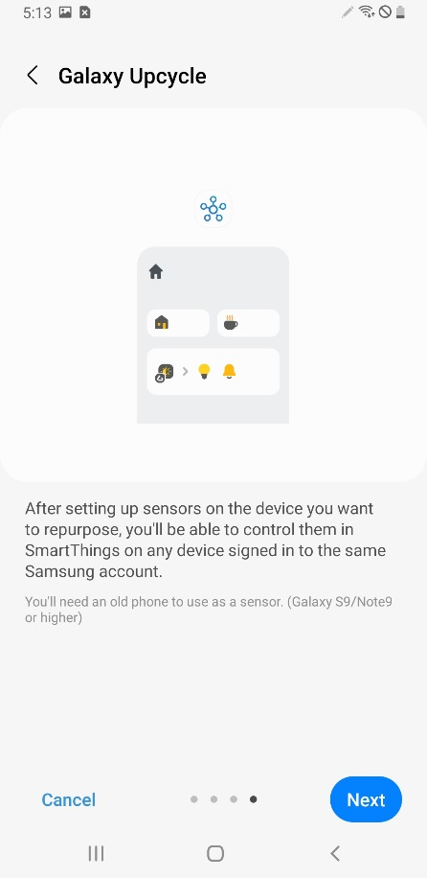
2.1. Installing Galaxy Upcycle App
UNIT 02
Install Galaxy Upcycle app in Old Galaxy (Click Labs in SmartThings app)
Notes:
[Instructor Guide]
Please read installation step carefully.
In using phone, show QR image to download.
In old phone, scan the QR image via camera app and tab popup url.
In old phone jump to Galaxy Store and install Galaxy Upcycle app.
[Key Message]

Slide 21
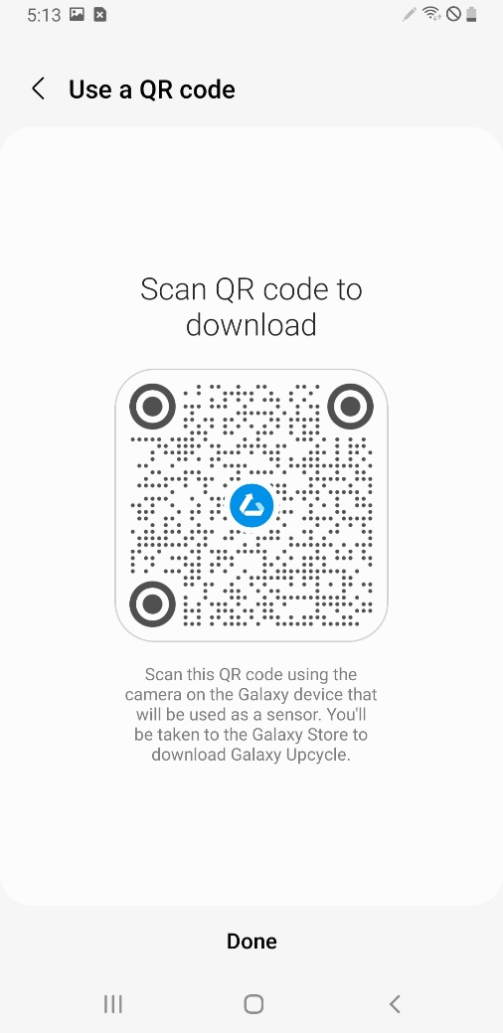
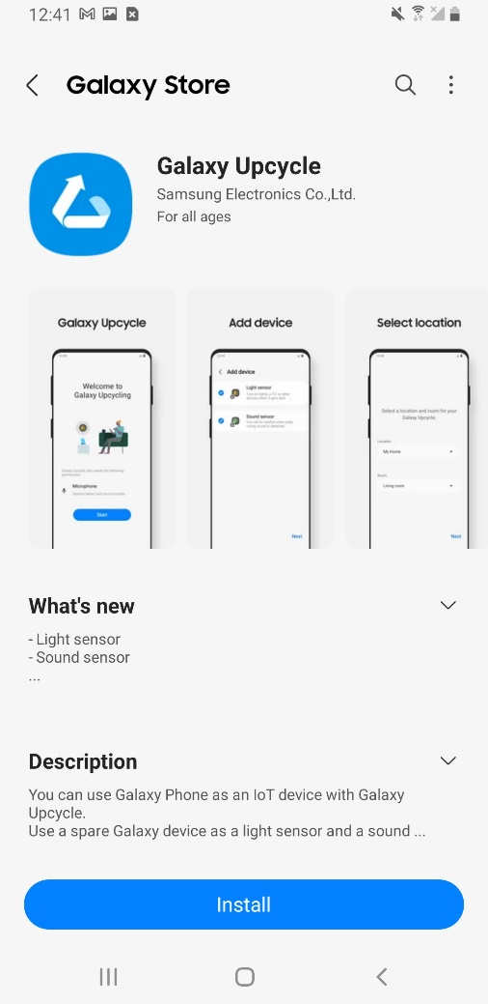
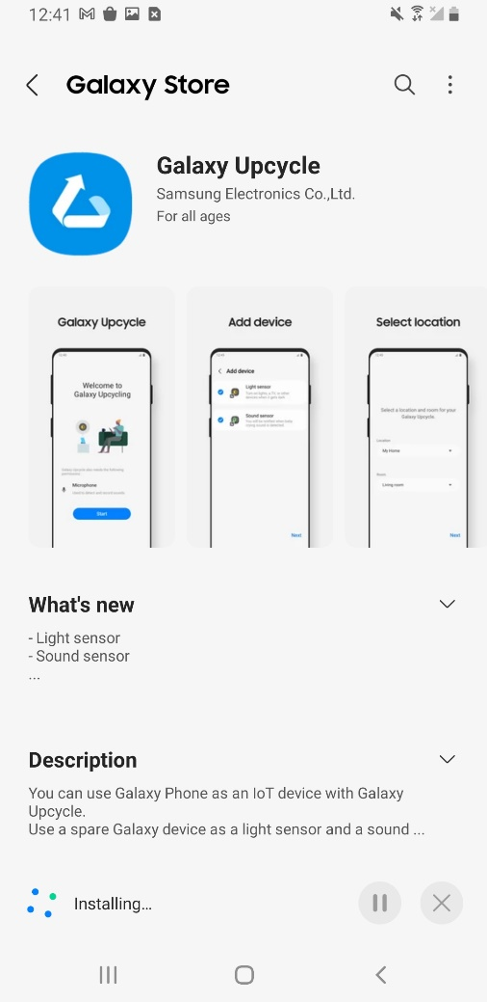
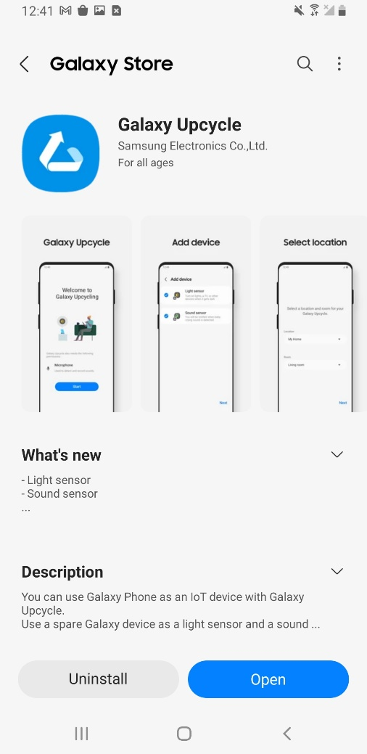
2.1. Installing Galaxy Upcycle App
UNIT 02
Install Galaxy Upcycle app in Old Galaxy (Click Labs in SmartThings app)
Notes:
[Instructor Guide]
Please read installation step carefully.
In using phone, show QR image to download.
In old phone, scan the QR image via camera app and tab popup url.
In old phone jump to Galaxy Store and install Galaxy Upcycle app.
[Key Message]

Slide 22
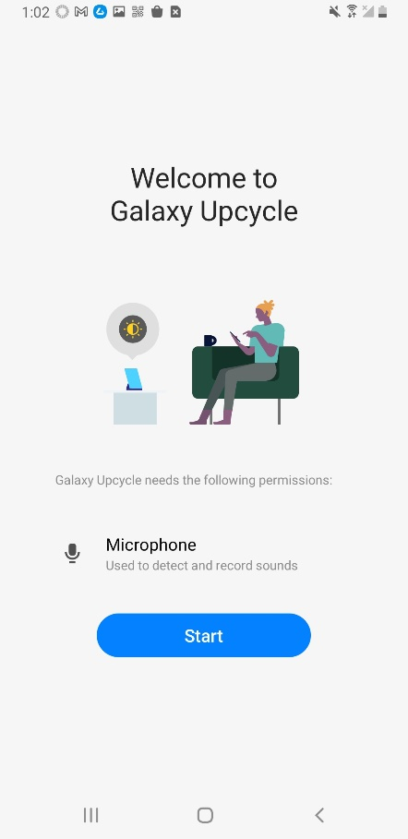
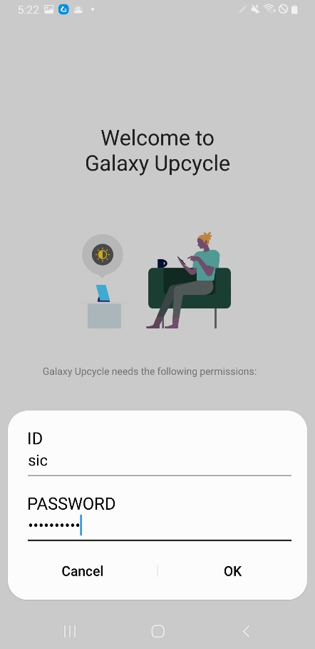
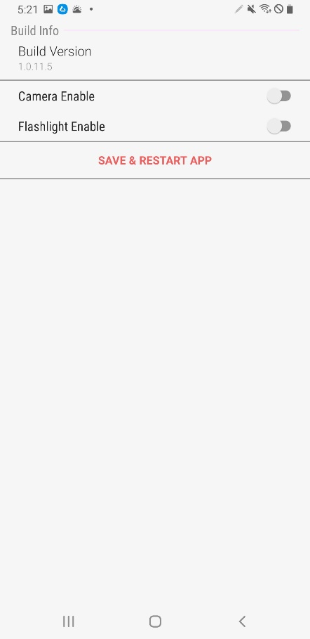
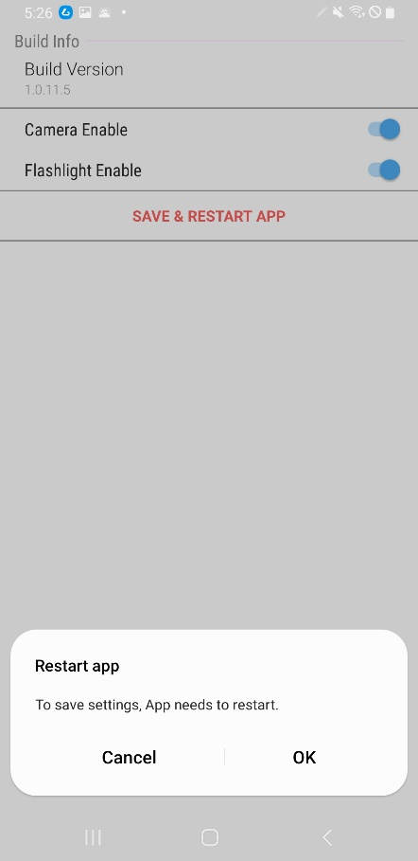
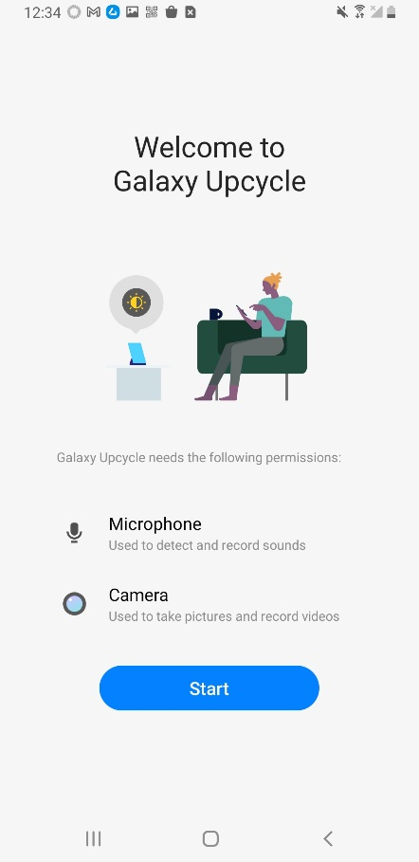
2.2. Adding SmartThings IoT Devices
UNIT 02
Enable hidden features in advance
To enable hidden features, tab image 10 times in welcome page, type SIC id/pw and save&restart
Notes:
[Instructor Guide]
Hidden features are currently under development and kept to hidden state. So students can use test mode option to enable them for SIC education purpose.
ID : sic
PW : sic!boomup
[Key Message]
Camera and flashlight are not official feature yet In Galaxy Upcycle app. So please use carefully only for SIC project.

Slide 23




2.2. Adding SmartThings IoT Devices
UNIT 02
Add Light sensor, Sound sensor and Flashlight (Option 1) (1/2)
Notes:
[Instructor Guide]
Galaxy Upcycle app currently support multi feature registration. Students can register Light sensor, Sound sensor and Flashlight by option 1.
[Key Message]
In commercial Home IoT environment, virtual allocation is matched with physical place. So students can select Location&Room to register.
After registration is done, old Galaxy starts to detect brightness level & sound source and control flashlight on/off.

Slide 24




2.2. Adding SmartThings IoT Devices
UNIT 02
Add Light sensor, Sound sensor and Flashlight (Option 1) (2/2)
Notes:
[Instructor Guide]
Galaxy Upcycle app currently support multi feature registration. Students can register Light sensor, Sound sensor and Flashlight by option 1.
[Key Message]
In commercial Home IoT environment, virtual allocation is matched with physical place. So students can select Location&Room to register.
After registration is done, old Galaxy starts to detect brightness level & sound source and control flashlight on/off.

Slide 25




2.2. Adding SmartThings IoT Devices
UNIT 02
Add Light sensor and Camera (Option 2) (1/2)
Notes:
[Instructor Guide]
Galaxy Upcycle app currently support multi feature registration. Students can register Camera and Light sensor by option 2.
By similar multimedia operation limit policy, Camera and Sound sensor can not be registered together!
By Android API limitation, Camera and Flashlight can not be registered together!
[Key Message]
In commercial Home IoT environment, virtual allocation is matched with physical place. So students can select Location&Room to register.
After registration is done, old Galaxy starts to detect motion/sound and brightness level.

Slide 26



2.2. Adding SmartThings IoT Devices
UNIT 02
Add Light sensor and Camera (Option 2) (2/2)
Notes:
[Instructor Guide]
Galaxy Upcycle app currently support multi feature registration. Students can register Camera and Light sensor by option 2.
By similar multimedia operation limit policy, Camera and Sound sensor can not be registered together!
By Android API limitation, Camera and Flashlight can not be registered together!
[Key Message]
In commercial Home IoT environment, virtual allocation is matched with physical place. So students can select Location&Room to register.
After registration is done, old Galaxy starts to detect motion/sound and brightness level.

Slide 27
Practice Status
UNIT 02
Part 3
Part 4
Smart Things
MCU
(ESP32)
Internet
MQTT
Part 2
Internet
Internet
Protocol
WebRTC
Internet
Using Galaxy with
SmartThings app
Old Galaxy with
Galaxy Upcycle app
Notes:
[Instructor Guide]
Practice Part 1 is done!!!
[Key Message]

Slide 28



2.3. Controlling IoT: Light Sensor
UNIT 02
Light Sensor
The IoT Thing uses a light sensor located on the front side of the Galaxy device.
The light sensor detects when it gets dark outside. It then signals the lights in your home to turn on.
Refer to this link https://www.samsung.com/levant/support/mobile-devices/galaxy-s9-what-is-the-device-layout/ , to see examples and routines.
Notes:
[Instructor Guide]
To operate properly with Light sensor, it’s required to know real location of physical HW component whether it’s broken or not in advance.
Originally the component is used to control display component.
Turn on/off display component during voice call
Adjust brightness level of display component at day/night condition
[Key Message]

Slide 29



2.3. Controlling IoT: Light Sensor
UNIT 02
Step 1 : SmartThings app → Devices → Light sensor card → Check Light status (7 Illuminance levels)
Notes:
[Instructor Guide]
In SmartThings app, students can enter Light sensor card and check current brightness level remotely.
[Key Message]

Slide 30





2.3. Controlling IoT: Light Sensor
UNIT 02
Step 2 : Routines Tab → Add Routine → Dark condition with illuminance level of Light sensor (1/3)
Notes:
[Instructor Guide]
In Routines tab of Light sensor plugin, students can add a routine. Like general routine creation, if/then condition can be selected like below condition.
- Dark condition
“If Illuminance level equal to or below 2 level, then send notification – Too dark, turn on bulb”
[Key Message]

Slide 31




2.3. Controlling IoT: Light Sensor
UNIT 02
Step 2 : Routines Tab → Add Routine → Dark condition with illuminance level of Light sensor (2/3)
Notes:
[Instructor Guide]
In Routines tab of Light sensor plugin, students can add a routine. Like general routine creation, if/then condition can be selected like below condition.
- Dark condition
“If Illuminance level equal to or below 2 level, then send notification – Too dark, turn on bulb”
[Key Message]

Slide 32




2.3. Controlling IoT: Light Sensor
UNIT 02
Step 2 : Routines Tab → Add Routine → Dark condition with illuminance level of Light sensor (3/3)
Notes:
[Instructor Guide]
In Routines tab of Light sensor plugin, students can add a routine. Like general routine creation, if/then condition can be selected like below condition.
- Dark condition
“If Illuminance level equal to or below 2 level, then send notification – Too dark, turn on bulb”
[Key Message]

Slide 33





2.3. Controlling IoT: Light Sensor
UNIT 02
Step 3 : Routines Tab → Add Routine → Bright condition with illuminance level of Light sensor (1/2)
Notes:
[Instructor Guide]
In Routines tab of Light sensor plugin, students can add a routine. Like general routine creation, if/then condition can be selected like below condition.
- Bright condition
“If Illuminance level equal to or above 3 level, then send notification – Turn off bulb”
[Key Message]

Slide 34





2.3. Controlling IoT: Light Sensor
UNIT 02
Step 3 : Routines Tab → Add Routine → Bright condition with illuminance level of Light sensor (2/2)
Step 4 : Make dark/bright condition with your finger → Check notification status
Notes:
[Instructor Guide]
In Routines tab of Light sensor plugin, students can add a routine. Like general routine creation, if/then condition can be selected like below condition.
- Bright condition
“If Illuminance level equal to or above 3 level, then send notification – Turn off bulb”
Let’s make real dark/bright condition. Students can hide/open HW light sensor component with their finger.
By created routines, notifications should be checked properly.
Menu -> Notifications
[Key Message]

Slide 35



2.3. Controlling IoT: Sound Sensor
UNIT 02
Sound Sensor
The IoT thing uses a microphone and a speaker located on the backside of the Galaxy device.
When the sound sensor detects sound, it can send an alarm or a message to your device.
Refer to this link https://www.samsung.com/levant/support/mobile-devices/galaxy-s9-what-is-the-device-layout/ , to see examples and routine.
Notes:
[Instructor Guide]
To operate properly with Sound sensor, it’s required to know real location of physical HW components whether it’s broken or not in advance.
Originally the components are used for voice call and multimedia operation.
Send/Receive sound during voice call
Play music and record sound
[Key Message]

Slide 36



2.3. Controlling IoT: Sound Sensor
UNIT 02
Step 1 : SmartThings app → Devices → Sound sensor card → Check Sound detection status (YAMNet)
Notes:
[Instructor Guide]
In SmartThings app, students can enter Sound sensor card and check current sound source remotely.
Sound detection is based on YAMNet
- https://github.com/tensorflow/examples/tree/master/lite/examples/sound_classification/android
[Key Message]

Slide 37



2.3. Controlling IoT: Sound Sensor
UNIT 02
Step 2 : Sound sensor card → More → Settings → Auto record sounds → Baby crying: On
Notes:
[Instructor Guide]
In Auto record sounds menu of Sound sensor plugin, students can turn on sound source.
- Baby crying
“If Baby crying sound is detected, then the sound will be recorded”
[Key Message]
‘All sound’ option can’t recognize any sound source. It only checks whether sound is detected or not.

Slide 38


2.3. Controlling IoT: Sound Sensor
UNIT 02
Step 3 : Sound sensor card → Timeline → Click baby icon → Check detected audio clip
Notes:
[Instructor Guide]
Let’s make real Baby crying sound condition. Students can play Baby crying sound via YouTube or other media contents.
By created routine, Baby crying icon will be shown in timeline and played the sound when clicked the icon.
[Key Message]

Slide 39
2.3. Controlling IoT: Camera
UNIT 02
Camera
The IoT Thing uses a microphone, speaker, flash and front/back camera located on the front/back side of the Galaxy device..
When the Camera detects motion or sound, it can capture or record with your device.
Refer to this link https://www.samsung.com/levant/support/mobile-devices/galaxy-s9-what-is-the-device-layout/, to see examples and routine.
Notes:
[Instructor Guide]
To operate properly with Camera, it’s required to know real location of physical HW components whether it’s broken or not in advance.
Originally the components are used for video call and multimedia operation.
Send/Receive video/sound during video call
Record Video/Audio and play Video clip
[Key Message]

Slide 40


2.3. Controlling IoT: Camera
UNIT 02
Step 1 : SmartThings app → Devices → Camera card → Check Live streaming status (WebRTC)
Video ratio is only controlled by rotate button on the old Galaxy device.
So adjust Portrait/Landscape before enabling live streaming.
Notes:
[Instructor Guide]
In SmartThings app, students can enter Camera card and check Live streaming and event video clips remotely.
Live streaming is a peer-to-peer connection based on WebRTC.
Video clips are saved in SmartThings Cloud.
[Key Message]

Slide 41



2.3. Controlling IoT: Camera
UNIT 02
Step 2 : Camera card → More → Settings → Record automatically → Motion/Notify: On
Notes:
[Instructor Guide]
In Record automatically menu of Camera plugin, students can turn on Motion detection.
- Motion detection
“If Motion is detected, then video will be recorded and sent notification”
[Key Message]

Slide 42


2.3. Controlling IoT: Camera
UNIT 02
Step 3 : Camera card → Video → Check detected video clip
Notes:
[Instructor Guide]
Let’s make some Motion condition in front of Camera.
By created routine, Motion detection will be shown in timeline and played the video when entered Clips menu.
[Key Message]

Slide 43

2.3. Controlling IoT: Flashlight
UNIT 02
Flashlight
The IoT Thing uses a flash located on the back side of the Galaxy device.
It can control turning the flashlight on/off with your device.
Refer this link https://www.samsung.com/levant/support/mobile-devices/galaxy-s9-what-is-the-device-layout/, to see examples and routine.
Notes:
[Instructor Guide]
To operate properly with Flashlight, it’s required to know real location of physical HW components whether it’s broken or not in advance.
Originally the component is used for camera operation or torch mode.
Brightness adjust during taking a picture or recording a video
Brighten place by user torch mode
[Key Message]

Slide 44



2.3. Controlling IoT: Flashlight
UNIT 02
Step 1 : SmartThings app → Devices → Light card → Check flashlight on/off and blinking
Notes:
[Instructor Guide]
In SmartThings app, students can enter Light card and check flashlight on/off and blinking remotely.
[Key Message]

Slide 45



2.3. Controlling IoT: Flashlight
UNIT 02
Step 2 : Light card → Routines tab → Add routine (+ button)
Step 3 : Make dark/bright condition with your finger → Check flashlight on/off status
Notes:
[Instructor Guide]
In Routines tab of Flashlight plugin, students can make interaction with brightness level.
- Brightness detection
“If Brightness is dark/bright, then turn on/off flashlight”
[Key Message]

Slide 46
Practice Status
UNIT 02
Part 3
Part 4
Smart Things
MCU
(ESP32)
Internet
MQTT
Internet
Internet
Protocol
WebRTC
Internet
Using Galaxy with
SmartThings app
Old Galaxy with
Galaxy Upcycle app
Notes:
[Instructor Guide]
Practice Part 2 is done!!!
[Key Message]

Slide 47
Unit 3.
SmartThings Device SDK to Control MCU
(Advanced Level)
3.1. Introduction to STDK
3.2. Dev Environment Setup
3.3. Build Test
Notes:
[Instructor Guide]
[Key Message]
In this lesson, we will take a deep dive with STDK. Commercial IoT things can be developed with STDK and controlled MCU and Galaxy Upcycle device combined with routine.

Slide 48
3.1. Introduction to STDK
UNIT 03
STDK is a toolkit for IoT Thing development with SmartThings Platform.
In this class, you can experience real-life IoT development and get MCU control know-how to become an IoT developer.

Slide 49

3.1. Introduction to STDK
UNIT 03
Full Introduction Video during SDC (Samsung Developer Conference) 2019
https://www.youtube.com/watch?v=Rjz0wept1fE
Notes:
[Instructor Guide]
SmartThings Device SDK is introduced with one session of SDC2019. Students can watch the session above YouTube link.
[Key Message]

Slide 50

3.1. Introduction to STDK
UNIT 03
Reference in Code Lab
https://developer.samsung.com/codelab/smartthings/smartthings-device-sdk/overview.html
Notes:
[Instructor Guide]
And there is a official Code Lab for SmartThings Device SDK. Students can follow the track step by step.
[Key Message]

Slide 51

3.1. Introduction to STDK
UNIT 03
Reference in SmartThings Community
https://community.smartthings.com/t/how-to-build-direct-connected-devices/204055
Notes:
[Instructor Guide]
Lastly STDK reference is also posted in SmartThings Community. Students can get help from the community.
[Key Message]

Slide 52

3.2. Dev Environment Setup
UNIT 03
Install Docker Desktop for simple build
https://www.docker.com/products/docker-desktop
Notes:
[Instructor Guide]
There is another magic tool, Docker container. With Docker container, students can setup Linux based development environment easily on any OS platform (Windows, Mac and Linux).
[Key Message]

Slide 53
3.2. Dev Environment Setup
UNIT 03
Get github project to use docker build file
$ git clone https://github.com/nanishin/stdk-docker-build.git
Cloning into 'stdk-docker-build'...
remote: Enumerating objects: 9, done.
remote: Counting objects: 100% (9/9), done.
remote: Compressing objects: 100% (9/9), done.
remote: Total 9 (delta 1), reused 5 (delta 0), pack-reused 0
Unpacking objects: 100% (9/9), done.
Checking connectivity... done.
Notes:
[Instructor Guide]
First of all, shell console is required to progress. Students can select below conditions.
Windows – WSL2 (Windows Subsystem for Linux 2)
Mac – terminal
Linux - terminal
Let’s use pre-defined Docker build configuration for STDK. Students can get the github project.
[Key Message]

Slide 54
3.2. Dev Environment Setup
UNIT 03
Run script file to prepare build environment
$ cd stdk-docker-build/
$ ./build_stdk_esp32.sh
[+] Building 3.2s (10/10) FINISHED
=> [internal] load build definition from stdk-common-env.dockerfile 0.0s
=> => transferring dockerfile: 933B 0.0s
=> [internal] load .dockerignore 0.0s
=> => transferring context: 2B 0.0s
=> [internal] load metadata for docker.io/library/ubuntu:20.04 3.0s
=> [auth] library/ubuntu:pull token for registry-1.docker.io 0.0s
=> [1/5] FROM docker.io/library/ubuntu:20.04@sha256:626ffe58f6e7566e00254b638eb7e0f3b11d4da9675088f4781a50ae288f3322 0.0s
=> [2/5] RUN dpkg --add-architecture i386 0.0s
=> [3/5] RUN ln -snf /usr/share/zoneinfo/Asia/Seoul /etc/localtime && echo Asia/Seoul > /etc/timezone 0.0s
=> [4/5] RUN apt-get update 0.0s
=> [5/5] RUN apt-get install -y --no-install-recommends gcc git wget make libncurses-dev flex bison gperf python3 python3-seri 0.0s
=> exporting to image 0.0s
=> => exporting layers 0.0s
=> => writing image sha256:a29bf1360ed35d8f61ab6dc513a466cecc678348de01390986244f04d8b2dfee 0.0s
=> => naming to docker.io/library/stdk_common_env 0.0s
Notes:
[Instructor Guide]
Docker build makes independent computing environment(Base OS Platform + Required packages to develop) to a Docker image. After that, a Docker container is created from the image.
Students can run build_stdk_esp32.sh script for automatic build.
In first step, stdk_common_env Docker images is created. It’s based on Ubuntu 20.04 and installed common development packages (gcc, git, make and etc.)
[Key Message]

Slide 55
3.2. Dev Environment Setup
UNIT 03
Run script file to prepare build environment
[+] Building 266.9s (15/15) FINISHED
=> [internal] load build definition from stdk-esp32-dev.dockerfile 0.0s
=> => transferring dockerfile: 1.10kB 0.0s
=> [internal] load .dockerignore 0.0s
=> => transferring context: 2B 0.0s
=> [internal] load metadata for docker.io/library/stdk_common_env:latest 0.0s
=> [ 1/11] FROM docker.io/library/stdk_common_env:latest 0.0s
=> [ 2/11] RUN cd /usr/bin/ && ln -sf python3 python 0.0s
=> [ 3/11] RUN git clone https://github.com/SmartThingsCommunity/st-device-sdk-c-ref.git 0.0s
=> [ 4/11] RUN echo 'export PATH='/usr/local/sbin:/usr/local/bin:/usr/sbin:/usr/bin:/sbin:/bin':/root/esp/xtensa-esp32-elf/bin' >> /root/.profile 0.0s
=> [ 5/11] RUN echo 'export IDF_PATH=/st-device-sdk-c-ref/bsp/esp32' >> /root/.profile 0.0s
=> [ 6/11] RUN echo 'export SHELL=/bin/bash' >> /root/.profile 0.4s
=> [ 7/11] RUN echo 'export GIT_DISCOVERY_ACROSS_FILESYSTEM=1' >> /root/.profile 0.4s
=> [ 8/11] WORKDIR /st-device-sdk-c-ref 0.1s
=> [ 9/11] RUN python setup.py esp32 210.3s
=> [10/11] RUN /st-device-sdk-c-ref/bsp/esp32/install.sh 34.6s
=> [11/11] RUN pip3 install pynacl pyserial qrcode 5.0s
=> exporting to image 15.9s
=> => exporting layers 15.9s
=> => writing image sha256:7cd93bb9897227636a881a27c0d192fffaac079239c614fc3398e892fb120a75 0.0s
=> => naming to docker.io/library/stdk_esp32_dev 0.0s
Notes:
[Instructor Guide]
In second step, stdk_esp32_dev Docker images is created. It’s based on stdk_common_env and followed below steps.
Clone STDK GitHub project
Install ESP32 toolchain
[Key Message]

Slide 56
3.2. Dev Environment Setup
UNIT 03
Check created docker images and run docker container to build
$ docker images
REPOSITORY TAG IMAGE ID CREATED SIZE
stdk_esp32_dev latest 7df3eb2fe815 3 minutes ago 1.83GB
stdk_common_env latest 16097de5e34e 8 minutes ago 463MB
$ docker run -it –v /YOUR_ABSOLUTE_PATH/output:/st-device-sdk-c-ref/output stdk_esp32_dev bash
root@e1ae8b10fa68:/st-device-sdk-c-ref# ls -al
total 96
drwxr-xr-x 1 root root 4096 Jul 5 00:27 .
drwxr-xr-x 1 root root 4096 Jul 5 00:36 ..
drwxr-xr-x 1 root root 4096 Jul 5 00:27 .git
drwxr-xr-x 2 root root 4096 Jul 5 00:27 .github
-rw-r--r-- 1 root root 8 Jul 5 00:27 .gitignore
-rw-r--r-- 1 root root 981 Jul 5 00:27 .gitmodules
-rwxr-xr-x 1 root root 11357 Jul 5 00:27 LICENSE
-rwxr-xr-x 1 root root 9359 Jul 5 00:27 README.md
drwxr-xr-x 11 root root 4096 Jul 5 00:27 apps
drwxr-xr-x 1 root root 4096 Jul 5 00:27 bsp
-rwxr-xr-x 1 root root 2781 Jul 5 00:27 build.py
-rwxr-xr-x 1 root root 1785 Jul 5 00:27 build.sh
drwxr-xr-x 3 root root 4096 Jul 5 00:27 doc
drwxr-xr-x 1 root root 4096 Jul 5 00:27 iot-core
drwxr-xr-x 11 root root 4096 Jul 5 00:27 patches
-rwxr-xr-x 1 root root 2362 Jul 5 00:27 setup.py
-rwxr-xr-x 1 root root 1551 Jul 5 00:27 setup.sh
drwxr-xr-x 12 root root 4096 Jul 5 00:27 tools
root@e1ae8b10fa68:/st-device-sdk-c-ref#
Notes:
[Instructor Guide]
After Docker build is done, students can check created 2 Docker images (stdk_common_env and stdk_esp32_dev).
A Docker container can be started with stdk_esp32_dev image and all dev environment setup is done.
Volume (-v) option is used to copy output files easily to container outside.
[Key Message]

Slide 57
3.3. Build Test
UNIT 03
Check build test with dummy device configuration data
root@ad7b99273e5e:/st-device-sdk-c-ref# . /root/.profile
root@ad7b99273e5e:/st-device-sdk-c-ref# ./build.py esp32 switch_example
Adding ESP-IDF tools to PATH...
Checking if Python packages are up to date...
Python requirements from /st-device-sdk-c-ref/bsp/esp32/requirements.txt are satisfied.
Updated PATH variable:
/st-device-sdk-c-ref/bsp/esp32/components/esptool_py/esptool:/st-device-sdk-c-ref/bsp/esp32/components/espcoredump:/st-device-sdk-c-ref/bsp/esp32/components/partition_table/:/root/.espressif/tools/xtensa-esp32-elf/esp-2019r2-8.2.0/xtensa-esp32-elf/bin:/root/.espressif/tools/esp32ulp-elf/2.28.51.20170517/esp32ulp-elf-binutils/bin:/root/.espressif/tools/openocd-esp32/v0.10.0-esp32-20190313/openocd-esp32/bin:/root/.espressif/python_env/idf4.0_py3.8_env/bin:/st-device-sdk-c-ref/bsp/esp32/tools:/usr/local/sbin:/usr/local/bin:/usr/sbin:/usr/bin:/sbin:/bin:/root/esp/xtensa-esp32-elf/bin
Done! You can now compile ESP-IDF projects.
Go to the project directory and run:
idf.py build
Checking Python dependencies…
Python requirements from /st-device-sdk-c-ref/bsp/esp32/requirements.txt are satisfied.
Executing action: all (aliases: build)
Running cmake in directory /st-device-sdk-c-ref/apps/esp32/switch_example/build
Executing "cmake -G 'Unix Makefiles' -DPYTHON_DEPS_CHECKED=1 -DESP_PLATFORM=1 —warn-uninitialized -DWARN_UNINITIALIZED=1 -DCCACHE_ENABLE=0 /st-device-sdk-c-ref/apps/esp32/switch_example"…
... Strings omitted ...
Notes:
[Instructor Guide]
In Docker container, students can try dummy STDK build to make stdk esp32 firmware.
To apply environment variables propelry before building, students should run source command in advance.
. /root/.profile
[Key Message]

Slide 58
3.3. Build Test
UNIT 03
Check build test with dummy device configuration data
... Strings omitted ...
Scanning dependencies of target __idf_main
[ 97%] Building C object esp-idf/main/CMakeFiles/__idf_main.dir/main.c.obj
[ 97%] Building C object esp-idf/main/CMakeFiles/__idf_main.dir/iot_cli_cmd.c.obj
[ 97%] Building C object esp-idf/main/CMakeFiles/__idf_main.dir/device_control.c.obj
[ 97%] Building C object esp-idf/main/CMakeFiles/__idf_main.dir/iot_uart_cli.c.obj
[ 98%] Building C object esp-idf/main/CMakeFiles/__idf_main.dir/caps_switch.c.obj
[ 98%] Building ASM object esp-idf/main/CMakeFiles/__idf_main.dir/__/__/device_info.json.S.obj
[ 98%] Building ASM object esp-idf/main/CMakeFiles/__idf_main.dir/__/__/onboarding_config.json.S.obj
[ 98%] Linking CXX static library libmain.a
[ 98%] Built target __idf_main
Scanning dependencies of target __ldgen_output_esp32.project.ld
[ 98%] Generating ld/esp32.project.ld
[ 98%] Built target __ldgen_output_esp32.project.ld
Scanning dependencies of target switch_example.elf
[ 98%] Building C object CMakeFiles/switch_example.elf.dir/project_elf_src.c.obj
[100%] Linking CXX executable switch_example.elf
[100%] Built target switch_example.elf
Scanning dependencies of target gen_project_binary
[100%] Generating binary image from built executable
esptool.py v2.8
Generated /st-device-sdk-c-ref/apps/esp32/switch_example/build/switch_example.bin
[100%] Built target gen_project_binary
Scanning dependencies of target app
[100%] Built target app
Project build complete. To flash, run this command:
/root/.espressif/python_env/idf4.0_py3.8_env/bin/python ../../../bsp/esp32/components/esptool_py/esptool/esptool.py -p (PORT) -b 460800 —before default_reset —after hard_reset write_flash —flash_mode dio —flash_size detect —flash_freq 40m 0x1000 build/bootloader/bootloader.bin 0x8000 build/partition_table/partition-table.bin 0x11000 build/ota_data_initial.bin 0x20000 build/switch_example.bin
or run 'idf.py -p (PORT) flash'
————————————————————————
binary path : /st-device-sdk-c-ref/output/esp32/iotcore_switch_example_20211213_3df85fe_57a3f55
————————————————————————
root@ad7b99273e5e:/st-device-sdk-c-ref#
Notes:
[Instructor Guide]
In Docker container, students can try dummy STDK build to make stdk esp32 firmware.
[Key Message]

Slide 59
Practice Status
UNIT 03
Part 4
Smart Things
MCU
(ESP32)
Internet
MQTT
Internet
Internet
Protocol
WebRTC
Internet
Using Galaxy with
SmartThings app
Old Galaxy with
Galaxy Upcycle app
Notes:
[Instructor Guide]
Practice Part 3 is done!!!
[Key Message]

Slide 60
Unit 4.
Final Configuration and Test: Smart Bulb
4.1. Steps
4.5. Register SIC Galup Direct Thing to ST App
4.2. Create a SmartThings Developer Account
4.6. Control/Routine Test
4.3. Create a New Project
4.7. Final Wrap-up
4.4. Add a Test Device
Notes:
[Instructor Guide]
[Key Message]
In this lesson, we will take a deep dive with SmartThings Developer Workspace. To become a real IoT thing device, the device should be operated with Cloud. SmartThings Developer Workspace supplies commercial environment to integrate custom IoT Thing device by 3rd party developer. Finally students can make several routine combination with Galaxy Upcycle based IoT thing and STDK MCU based IoT thing.

Slide 61
4.1. Steps
UNIT 04
Estimated Time : 20 mins
Register as a developer for Developer Workspace and register a device through Developer Workspace
Register as a developer for Developer Workspace
Create a new project – Device Integration – Direct-connected
Create Device Profile as sic-galup-thing-01 with Switch capability
Create Device Onboarding
Create Product Info
Add Test Device with Device Identity (Serial Number and Public Key)
Notes:
[Instructor Guide]
Step by step guide
[Key Message]

Slide 62

4.2. Create a SmartThings Developer Account
UNIT 04
Go to https://smartthings.developer.samsung.com
Notes:
[Instructor Guide]
Step by step guide
[Key Message]

Slide 63

4.2. Create a SmartThings Developer Account
UNIT 04
Sign up with SmartThings Account
Notes:
[Instructor Guide]
Step by step guide
[Key Message]
You will need a Samsung Account to create a SmartThings Developer Account. If you do not have a Samsung Account, create one first.

Slide 64

4.2. Create a SmartThings Developer Account
UNIT 04
Check TNC and click NEXT
Notes:
[Instructor Guide]
Step by step guide
[Key Message]
The TNC procedure is required to assign a unique MNID(Manufacturer ID) per Samsung account.

Slide 65

4.2. Create a SmartThings Developer Account
UNIT 04
Now signing up is done
Notes:
[Instructor Guide]
Step by step guide
[Key Message]
You are now ready to be a SmartThings developer.

Slide 66

4.3. Create a New Project
UNIT 04
Go to “Workspace” and create a new project
Notes:
[Instructor Guide]
Step by step guide
[Key Message]
Now we'll register the device with SmartThings.

Slide 67

4.3. Create a New Project
UNIT 04
Choose Device Integration
Notes:
[Instructor Guide]
Step by step guide
[Key Message]
To register a device newly to SmartThings Cloud, the menu is used.

Slide 68

4.3. Create a New Project
UNIT 04
Choose Direct-connected
Notes:
[Instructor Guide]
There are three type devices in SmartThings Platform.
Direct-connected (Connect to SmartThings Cloud with STDK)
Cloud-connected (Connect to SmartThings Cloud with other 3rd party Cloud connector like AWS Lambda or Webhook Endpoint)
Hub-connected (Connect to SmartThings Cloud with SmartThings Hub)
[Key Message]

Slide 69

4.3. Create a New Project
UNIT 04
Type direct-connected device name (e.g. sic-galup-thing-01) and click CREATE PROJECT button
Notes:
[Instructor Guide]
Step by step guide
[Key Message]

Slide 70

4.3 Add a Device Profile
UNIT 04
Choose DEFINE DEVICE PROFILE
Notes:
[Instructor Guide]
Step by step guide
[Key Message]

Slide 71

4.3 Add a Device Profile
UNIT 04
Choose CREATE DEVICE PROFILE button
Notes:
[Instructor Guide]
Step by step guide
[Key Message]

Slide 72

4.3 Add a Device Profile
UNIT 04
Type a name into Device Profile Name (e.g. sic-galup-thing-01) and choose Device Type (e.g. Switch)
Notes:
[Instructor Guide]
Step by step guide
[Key Message]

Slide 73



4.3 Add a Device Profile
UNIT 04
Click ADD CAPABILITY button, add some Capabilities (e.g. Switch) and click NEXT button
Notes:
[Instructor Guide]
Step by step guide
[Key Message]

Slide 74

4.3 Add a Device Profile
UNIT 04
Choose Dashboard State (e.g. Switch) and Dashboard Action (e.g. Switch)
Notes:
[Instructor Guide]
Step by step guide
[Key Message]

Slide 75



4.3 Add a Device Profile
UNIT 04
Check saved Device Profile and download Device Configuration json file (Customized UI Purpose)
Notes:
[Instructor Guide]
Step by step guide
[Key Message]

Slide 76

4.3 Add a Device Profile
UNIT 04
Choose ADD DEVICE ONBOARDING button
Notes:
[Instructor Guide]
Step by step guide
[Key Message]

Slide 77

4.3 Add a Device Profile
UNIT 04
Choose ED25519 for Authentication Type and type Onboarding Display Name (e.g. SIC GalUp Thing 01)
Notes:
[Instructor Guide]
Step by step guide
[Key Message]

Slide 78


4.3 Add a Device Profile
UNIT 04
Check Onboarding Screens (Discover and Introduction)
Notes:
[Instructor Guide]
Step by step guide
[Key Message]

Slide 79



4.3 Add a Device Profile
UNIT 04
Check Onboarding Screens (Use Button Confirm) and choose CREATE DEVICE ONBOARDING button
Notes:
[Instructor Guide]
Step by step guide
[Key Message]

Slide 80

4.3 Add a Device Profile
UNIT 04
Choose ADD DEVICE ONBOARDING TO PROJECT button
Notes:
[Instructor Guide]
Step by step guide
[Key Message]

Slide 81

4.3 Add a Device Profile
UNIT 04
Check saved Device Onboarding
Notes:
[Instructor Guide]
Step by step guide
[Key Message]

Slide 82

4.3 Add a Device Profile
UNIT 04
Type Product Name, SKU and choose Category, choose SAVE PRODUCT button
Please add your country!
Notes:
[Instructor Guide]
Step by step guide
[Key Message]

Slide 83

4.3 Add a Device Profile
UNIT 04
Check saved Product Info
Notes:
[Instructor Guide]
Step by step guide
[Key Message]

Slide 84


4.3 Add a Device Profile
UNIT 04
Click DEPLOY TO TEST button and choose DOWNLOAD ONBOARDING_CONFIG.JSON button
Notes:
[Instructor Guide]
Step by step guide
[Key Message]

Slide 85

4.3 Add a Device Profile
UNIT 04
Check Current status
Notes:
[Instructor Guide]
Step by step guide
[Key Message]

Slide 86

4.4. Add a Test Device
UNIT 04
Choose REGISTER NEW DEVICE button
Notes:
[Instructor Guide]
Step by step guide
[FAQ]
If students want to modify it after 'Deployed to Test', you must proceed in the following order to prevent errors. 1. Remove the test device from the 'Test Devices' menu 2. Return to undistributed state (Deploy to test → Unlist from test) 3. Modification in the project (Device Onboarding, Product Info) 4. Save and re-distribute after modification is completed (Deploy to Test) 5. Download the modified ‘onboarding_info.json' file again 6. Re-register test device in 'Test Devices' 7. Retest after firmware flash the test device
7-1 . The following two files must be synchronized with the contents in parentheses.
- device_info.json file (device classification)
- onboarding_info.json (Definition of onboarding method)

Slide 87

4.4. Add a Test Device
UNIT 04
Type Serial Number and Public Key generated from STDK
root@e1ae8b10fa68:/st-device-sdk-c-ref# cd /st-device-sdk-c-ref/iot-core/tools/keygen/
root@e1ae8b10fa68:/st-device-sdk-c-ref/iot-core/tools/keygen# ls -al
total 32
drwxr-xr-x 2 root root 4096 Jul 5 00:27 .
drwxr-xr-x 4 root root 4096 Jul 5 00:27 ..
-rw-r--r-- 1 root root 6369 Jul 5 00:27 README.md
-rwxr-xr-x 1 root root 13032 Jul 5 00:27 stdk-keygen.py
root@e1ae8b10fa68:/st-device-sdk-c-ref/iot-core/tools/keygen# python stdk-keygen.py --mnid YOUR_MNID --firmware YOUR_VERSION
-----------------------------NOTICE----------------------------------
qrcode module failed to import. QR code generation will not execute.
If you want to make QR code, please install qrcode module first.
---------------------------------------------------------------------
Use following serial number and public key
for the identity of your device in Developer Workspace.
Serial Number:
STDKYOUR_MNIDJHiEHdaC
Public Key:
CX/Ir8vBqcn+OHEFYsxL0gWKmMmR16KESOtS9GEjG/E=
root@e1ae8b10fa68:/st-device-sdk-c-ref/iot-core/tools/keygen#
Notes:
[Instructor Guide]
Step by step guide
[Key Message]

Slide 88

4.4. Add a Test Device
UNIT 06
Check saved Test Device
Notes:
[Instructor Guide]
Step by step guide
[Key Message]

Slide 89
4.4. Add a Test Device
UNIT 04
Update device configuration file (device_info.json)
root@e1ae8b10fa68:/st-device-sdk-c-ref/iot-core/tools/keygen# ls -al output_STDKYOUR_MNIDJHiEHdaC/
total 20
drwxr-xr-x 2 root root 4096 Jul 5 01:20 .
drwxr-xr-x 1 root root 4096 Jul 5 01:20 ..
-rw-r--r-- 1 root root 44 Jul 5 01:20 device.pubkey.b64
-rw-r--r-- 1 root root 44 Jul 5 01:20 device.seckey.b64
-rw-r--r-- 1 root root 222 Jul 5 01:20 device_info.json
root@e1ae8b10fa68:/st-device-sdk-c-ref/iot-core/tools/keygen# cat output_STDKYOUR_MNIDJHiEHdaC/device_info.json
{
"deviceInfo": {
"firmwareVersion": "V20210705",
"privateKey": "xPSS3QFuTjhSRuqH9zqD+QXs9ZLgm3Ojet1TKSvEkfw=",
"publicKey": "CX/Ir8vBqcn+OHEFYsxL0gWKmMmR16KESOtS9GEjG/E=",
"serialNumber": "STDKYOUR_MNIDJHiEHdaC"
}
}
root@e1ae8b10fa68:/st-device-sdk-c-ref/iot-core/tools/keygen# cat /st-device-sdk-c-ref/apps/esp32/switch_example/main/device_info.json
{
"deviceInfo": {
"firmwareVersion": "firmwareVersion_here",
"privateKey": "privateKey_here",
"publicKey": "publicKey_here",
"serialNumber": "serialNumber_here"
}
}
root@e1ae8b10fa68:/st-device-sdk-c-ref/iot-core/tools/keygen# cp output_STDKfcAMJHiEHdaC/device_info.json /st-device-sdk-c-ref/apps/esp32/switch_example/main/device_info.json
Notes:
[Instructor Guide]
Overwrite device_info.json with proper configuration
[Key Message]

Slide 90
4.4. Add a Test Device
UNIT 04
Update device configuration file (onboarding_config.json) (1/2)
$ docker ps
CONTAINER ID IMAGE COMMAND CREATED STATUS PORTS NAMES
e1ae8b10fa68 stdk_esp32_dev "bash" 2 hours ago Up 3 seconds blissful_shtern
$ docker exec e1ae cat /st-device-sdk-c-ref/apps/esp32/switch_example/main/onboarding_config.json
{
"onboardingConfig": {
"deviceOnboardingId": "NAME",
"mnId": "MNID",
"setupId": "999",
"vid": "VID",
"deviceTypeId": "TYPE",
"ownershipValidationTypes": [
"JUSTWORKS",
"BUTTON",
"PIN",
"QR"
],
"identityType": "ED25519",
"deviceIntegrationProfileKey": {
"id": "DIP_UUID",
"majorVersion": 0,
"minorVersion": 1
}
}
}
Notes:
[Instructor Guide]
Overwrite onboarding_config.json with proper configuration
[Key Message]

Slide 91
4.4. Add a Test Device
UNIT 04
Update device configuration file (onboarding_config.json) (2/2)
$ docker cp onboarding_config.json e1ae:/st-device-sdk-c-ref/apps/esp32/swtch_example/main/onboarding_config.json
$ docker exec e1ae cat /st-device-sdk-c-ref/apps/esp32/switch_example/main/onboarding_config.json
{
"onboardingConfig": {
"deviceOnboardingId": "SIC_GalUp_Thi",
"mnId": “YOUR_MNID",
"setupId": "001",
"vid": "ST_YOUR_VERSION_ID",
"deviceTypeId": "Switch",
"ownershipValidationTypes": [
“BUTTON"
],
"identityType": "ED25519",
"deviceIntegrationProfileKey": {
"id": “YOUR_DEVICE_ID",
"majorVersion": 0,
"minorVersion": 1
},
"productId": "7dce8ed8-74cc-4b02-9c04-f2e0c45de33c"
}
}
$ docker exec e1ae ls -al /st-device-sdk-c-ref/apps/esp32/switch_example/main/onboarding_config.json
-rw-r—r— 1 501 dialout 489 Dec 13 20:23 /st-device-sdk-c-ref/apps/esp32/switch_example/main/onboarding_config.json
$ docker exec e1ae chown root:root /st-device-sdk-c-ref/apps/esp32/switch_example/main/onboarding_config.json
$ docker exec e1ae ls -al /st-device-sdk-c-ref/apps/esp32/switch_example/main/onboarding_config.json
-rw-r—r— 1 root root 489 Dec 13 20:23 /st-device-sdk-c-ref/apps/esp32/switch_example/main/onboarding_config.json
Notes:
[Instructor Guide]
Overwrite onboarding_config.json with proper configuration
Found esp32 booting error by wrong permission of onboarding_config.json file.
So it’s required to update file permission with chown command.
[Key Message]

Slide 92
4.4. Add a Test Device
UNIT 04
Build with updated device configuration files (device_info.json and onboarding_config.json)
$ docker ps
CONTAINER ID IMAGE COMMAND CREATED STATUS PORTS NAMES
ad7b99273e5e stdk_esp32_dev "bash" 2 hours ago Up 13 minutes blissful_shtern
$ docker attach ad7b
root@ad7b99273e5e:/st-device-sdk-c-ref# ./build.py esp32 switch_example
... Strings omitted ...
[ 97%] Linking CXX static library libmain.a
[ 98%] Built target __idf_main
[ 98%] Generating ld/esp32.project.ld
[ 98%] Built target __ldgen_output_esp32.project.ld
[100%] Linking CXX executable switch_example.elf
[100%] Built target switch_example.elf
[100%] Generating binary image from built executable
esptool.py v2.8
Generated /st-device-sdk-c-ref/apps/esp32/switch_example/build/switch_example.bin
[100%] Built target gen_project_binary
[100%] Built target app
Project build complete. To flash, run this command:
/root/.espressif/python_env/idf4.0_py3.8_env/bin/python ../../../bsp/esp32/components/esptool_py/esptool/esptool.py -p (PORT) -b 460800 --before default_reset --after hard_reset write_flash --flash_mode dio --flash_size detect --flash_freq 40m 0x1000 build/bootloader/bootloader.bin 0x8000 build/partition_table/partition-table.bin 0x11000 build/ota_data_initial.bin 0x20000 build/switch_example.bin
or run 'idf.py -p (PORT) flash'
————————————————————————
binary path : /st-device-sdk-c-ref/output/esp32/iotcore_switch_example_20211213_3df85fe_57a3f55
————————————————————————
root@ad7b99273e5e:/st-device-sdk-c-ref#
Notes:
[Instructor Guide]
Step by step guide
[Key Message]

Slide 93
4.4. Add a Test Device
UNIT 04
Check output firmware images and get esptool
$ cd output/esp32/iotcore_switch_example_latest
$ ls -al
total 1952
drwxr-xr-x 7 nani staff 224 12 13 17:17 .
drwxr-xr-x 4 nani staff 128 12 13 17:17 ..
-rw-r—r— 1 nani staff 24672 12 13 17:17 bootloader.bin
drwxr-xr-x 8 nani staff 256 12 13 17:17 debug
-rw-r—r— 1 nani staff 8192 12 13 17:17 ota_data_initial.bin
-rw-r—r— 1 nani staff 3072 12 13 17:17 partition-table.bin
-rw-r—r— 1 nani staff 955696 12 13 17:17 switch_example.bin
$ git clone https://github.com/espressif/esptool.git
Cloning into 'esptool'...
remote: Enumerating objects: 3225, done.
remote: Counting objects: 100% (262/262), done.
remote: Compressing objects: 100% (215/215), done.
remote: Total 3225 (delta 162), reused 144 (delta 47), pack-reused 2963
Receiving objects: 100% (3225/3225), 10.25 MiB | 7.71 MiB/s, done.
Resolving deltas: 100% (2032/2032), done.
Checking connectivity... done.
Notes:
[Instructor Guide]
Step by step guide
The container id is changed whenever created.
So students should check their own contailer id.
docker ps -a
[Key Message]

Slide 94

4.4. Add a Test Device
UNIT 04
Install USB serial driver for Windows/Mac/Linux
https://www.silabs.com/developers/usb-to-uart-bridge-vcp-drivers
Notes:
[Instructor Guide]
Students can install USB serial driver to communicate with esp32.
cp210x chip is commonly used to support USB communication in this kind of devkit board.
FYI, sometimes cheap devkit board use ch340 chip instead of cp210x. Then ch340 USB serial drvier is required to install.
After esp32 devkit board is connected with PC, USB serial device will be shown like below.
Windows : COMX
Mac : /dev/tty.usbserial-XXXX or /dev/tty.SLAB_USBtoUART
Linux : /dev/ttyACMX or /dev/ttyUSBX
[Key Message]

Slide 95



4.4. Add a Test Device
UNIT 04
Use esp flash tool for Windows
https://www.espressif.com/en/support/download/other-tools
Notes:
[Instructor Guide]
Students can select esp flash tool based on OS Platform.
To flash ESP32 firmware properly, refer each binary address
0x1000 bootloader.bin
0x8000 partition-table.bin
0x11000 ota_data_initial.bin
0x20000 switch_example.bin
To enter esp32 download mode, students can click boot button on the board.
[Key Message]

Slide 96
4.4. Add a Test Device
UNIT 04
Use esp flash cli for Mac/Linux (1/2)
$ pwd
/YOUR_ABSOLUTE_PATH/stdk-docker-build/output/esp32/iotcore_switch_example_latest
$ python3 ../../../esptool/esptool.py -p /dev/tty.SLAB_USBtoUART erase_flash
esptool.py v3.3-dev
Serial port /dev/tty.SLAB_USBtoUART
Connecting.....
Detecting chip type... Unsupported detection protocol, switching and trying again...
Connecting...........
Detecting chip type... ESP32
Chip is ESP32-D0WD (revision 1)
Features: WiFi, BT, Dual Core, Coding Scheme None
Crystal is 40MHz
MAC: 30:ae:a4:97:48:d8
Uploading stub...
Running stub...
Stub running...
Erasing flash (this may take a while)...
Chip erase completed successfully in 8.5s
Hard resetting via RTS pin...
$ python3 ../../../esptool/esptool.py -p /dev/tty.usbserial-0001 -b 460800 --before default_reset --after hard_reset write_flash --flash_mode dio --flash_size detect --flash_freq 40m 0x1000 ./bootloader.bin 0x8000 ./partition-table.bin 0x11000 ./ota_data_initial.bin 0x20000 ./switch_example.bin
esptool.py v3.3-dev
Serial port /dev/tty.usbserial-0001
Connecting...........
Detecting chip type... Unsupported detection protocol, switching and trying again...
Connecting....
Detecting chip type... ESP32
Chip is ESP32-D0WDQ6 (revision 1)
Notes:
[Instructor Guide]
Students can select esp flash tool based on OS Platform.
If some python package (i.e ImportError: No module named serial) error is occured, then students can install dependency package.
pip3 install pyserial
To flash ESP32 firmware properly, refer each binary address
0x1000 bootloader.bin
0x8000 partition-table.bin
0x11000 ota_data_initial.bin
0x20000 switch_example.bin
To enter esp32 download mode, students can click boot button on the board.
And students can use erash flash to resolve booting error
python3 ../esptool/esptool.py –p /dev/tty.usbserial-0001 erase_flash
[Key Message]

Slide 97
4.4. Add a Test Device
UNIT 04
Use esp flash cli for Mac & Linux (2/2)
Features: WiFi, BT, Dual Core, 240MHz, VRef calibration in efuse, Coding Scheme None
Crystal is 40MHz
MAC: YOUR_ESP32_MAC_ADDRESS
Uploading stub...
Running stub...
Stub running...
Changing baud rate to 460800
Changed.
Configuring flash size…
Auto-detected Flash size: 4MB
Flash will be erased from 0x00001000 to 0x00007fff…
Flash will be erased from 0x00008000 to 0x00008fff…
Flash will be erased from 0x00011000 to 0x00012fff…
Flash will be erased from 0x00020000 to 0x00109fff…
Compressed 24672 bytes to 14685…
Wrote 24672 bytes (14685 compressed) at 0x00001000 in 0.8 seconds (effective 250.0 kbit/s)…
Hash of data verified.
Compressed 3072 bytes to 151…
Wrote 3072 bytes (151 compressed) at 0x00008000 in 0.1 seconds (effective 247.9 kbit/s)…
Hash of data verified.
Compressed 8192 bytes to 31…
Wrote 8192 bytes (31 compressed) at 0x00011000 in 0.1 seconds (effective 451.2 kbit/s)…
Hash of data verified.
Compressed 955648 bytes to 616526…
Wrote 955648 bytes (616526 compressed) at 0x00020000 in 15.1 seconds (effective 505.3 kbit/s)…
Hash of data verified.
Leaving…
Hard resetting via RTS pin…
Notes:
[Instructor Guide]
Students can select esp flash tool based on OS Platform.
If some python package (i.e ImportError: No module named serial) error is occured, then students can install dependency package.
pip3 install pyserial
To flash ESP32 firmware properly, refer each binary address
0x1000 bootloader.bin
0x8000 partition-table.bin
0x11000 ota_data_initial.bin
0x20000 switch_example.bin
[Key Message]

Slide 98
4.4. Add a Test Device
UNIT 04
Check esp32 booting status whether it’s normal or not (1/3)
$ miniterm.py --raw --eol CR --encoding ascii /dev/tty.SLAB_USBtoUART 115200
--- Miniterm on /dev/tty.SLAB_USBtoUART 115200,8,N,1 ---
--- Quit: Ctrl+] | Menu: Ctrl+T | Help: Ctrl+T followed by Ctrl+H ---
MSH?HH???0x1 (POWERON_RESET),boot:0x13 (SPI_FAST_FLASH_BOOT)
configsip: 0, SPIWP:0xee
clk_drv:0x00,q_drv:0x00,d_drv:0x00,cs0_drv:0x00,hd_drv:0x00,wp_drv:0x00
mode:DIO, clock div:2
load:0x3fff0018,len:4
load:0x3fff001c,len:5676
load:0x40078000,len:14440
load:0x40080400,len:4460
entry 0x4008069c
I (339) cpu_start: Pro cpu up.
I (339) cpu_start: Application information:
I (339) cpu_start: Project name: switch_example
I (342) cpu_start: App version: v1.7.0-29-g3df85fe-dirty
I (349) cpu_start: Compile time: Dec 13 2021 16:45:39
I (355) cpu_start: ELF file SHA256: 1a545297fa99736a...
I (361) cpu_start: ESP-IDF: v4.0.1-316-g48ea44f3d1
I (367) cpu_start: Single core mode
I (371) heap_init: Initializing. RAM available for dynamic allocation:
I (378) heap_init: At 3FFAE6E0 len 00001920 (6 KiB): DRAM
I (384) heap_init: At 3FFB9268 len 00026D98 (155 KiB): DRAM
I (391) heap_init: At 3FFE0440 len 0001FBC0 (126 KiB): D/IRAM
I (397) heap_init: At 40078000 len 00008000 (32 KiB): IRAM
I (403) heap_init: At 400956BC len 0000A944 (42 KiB): IRAM
I (409) cpu_start: Pro cpu start user code
I (427) spi_flash: detected chip: generic
I (427) spi_flash: flash io: qio
Notes:
[Instructor Guide]
Students can check esp32 booting status with usb serial monitor
miniterm.py –p /dev/tty.SLAB_USBtoUART 115200
[Key Message]

Slide 99
4.4. Add a Test Device
UNIT 04
Check esp32 booting status whether it’s normal or not (2/3)
I (427) cpu_start: Starting scheduler on PRO CPU.
I (451) [IoT]: _dump_device_info(706) > firmware_version: V20211213
I (451) [IoT]: iot_bsp_wifi_init(178) > [esp32] iot_bsp_wifi_init
I (461) wifi:wifi driver task: 3ffc2478, prio:23, stack:6656, core=0
I (461) system_api: Base MAC address is not set, read default base MAC address from BLK0 of EFUSE
I (461) system_api: Base MAC address is not set, read default base MAC address from BLK0 of EFUSE
I (481) wifi:wifi firmware version: 9156a0d
I (481) wifi:config NVS flash: enabled
I (481) wifi:config nano formating: disabled
I (491) wifi:Init data frame dynamic rx buffer num: 32
I (491) wifi:Init management frame dynamic rx buffer num: 32
I (501) wifi:Init management short buffer num: 32
I (501) wifi:Init dynamic tx buffer num: 32
I (501) wifi:Init static rx buffer size: 1600
I (511) wifi:Init static rx buffer num: 10
I (511) wifi:Init dynamic rx buffer num: 32
I (521) [IoT]: iot_bsp_wifi_init(216) > [esp32] iot_bsp_wifi_init done
I (521) [IoT]: st_conn_init(1372) > previous error code[]
I (531) [IoT]: st_conn_init(1380) > stdk_version : 1.7.4
I (541) gpio: GPIO[12]| InputEn: 0| OutputEn: 1| OpenDrain: 0| Pullup: 0| Pulldown: 1| Intr:0
I (541) gpio: GPIO[26]| InputEn: 0| OutputEn: 1| OpenDrain: 0| Pullup: 0| Pulldown: 1| Intr:0
I (551) gpio: GPIO[14]| InputEn: 0| OutputEn: 1| OpenDrain: 0| Pullup: 0| Pulldown: 1| Intr:0
I (561) gpio: GPIO[27]| InputEn: 0| OutputEn: 1| OpenDrain: 0| Pullup: 0| Pulldown: 1| Intr:0
I (571) gpio: GPIO[13]| InputEn: 1| OutputEn: 0| OpenDrain: 0| Pullup: 1| Pulldown: 0| Intr:3
I (2581) [IoT]: st_conn_start(1850) > st_conn_start start (no-pin)
I (2581) [IoT]: _do_iot_main_command(499) > curr_main_cmd:10, curr_main_state:-1/-1
I (2581) [IoT]: _do_update_timeout(200) > Current timeout : 100000 for -1/0
I (2591) [IoT]: _do_status_report(304) > Call usr status_cb with 1/0
status: 1, stat: 0
Notes:
[Instructor Guide]
Students can check firmware status with usb serial monitor
miniterm.py –p /dev/tty.SLAB_USBtoUART 115200
[Key Message]

Slide 100
4.4. Add a Test Device
UNIT 04
Check esp32 booting status whether it’s normal or not (3/3)
I (2601) [IoT]: _do_iot_main_command(499) > curr_main_cmd:2, curr_main_state:-1/0
I (2611) [IoT]: _do_cmd_tout_check(1041) > New state updated for 0
I (2611) [IoT]: _do_iot_main_command(499) > curr_main_cmd:10, curr_main_state:0/0
I (2621) [IoT]: iot_bsp_wifi_set_mode(234) > iot_bsp_wifi_set_mode = 1
I (2711) phy: phy_version: 4180, cb3948e, Sep 12 2019, 16:39:13, 0, 0
I (2711) wifi:mode : sta (30:ae:a4:97:48:d8)
I (2711) [IoT]: iot_bsp_wifi_set_mode(265) > WiFi Station Started
I (4761) [IoT]: event_handler(167) > event_handler = 1
I (4811) [IoT]: iot_easysetup_create_ssid(91) > >> SIC GalUp Thi[eips] <<
I (4811) [IoT]: _do_update_timeout(200) > Current timeout : 300000 for 0/1
I (4811) [IoT]: _do_iot_main_command(499) > curr_main_cmd:1, curr_main_state:0/1
I (4821) [IoT]: iot_bsp_wifi_set_mode(234) > iot_bsp_wifi_set_mode = 3
I (4831) wifi:mode : sta (YOUR_ESP32_WIFI_MAC) + softAP (YOUR_ESP32_SOFTAP_MAC)
I (4831) wifi:Total power save buffer number: 16
I (4841) wifi:Init max length of beacon: 752/752
I (4841) wifi:Init max length of beacon: 752/752
I (5821) wifi:Total power save buffer number: 16
I (5831) [IoT]: event_handler(135) > SYSTEM_EVENT_AP_START
I (5831) [IoT]: iot_bsp_wifi_set_mode(382) > AP Mode Started
I (5831) [IoT]: iot_easysetup_init(494) > IOT_STATE_PROV_ES_START
I (5841) [IoT]: es_http_init(159) > http tcp init!!
I (5841) [IoT]: iot_easysetup_init(531) > IOT_STATE_PROV_ES_INIT_DONE
I (5851) [IoT]: event_handler(140) > SYSTEM_EVENT_AP_STOP
I (5861) [IoT]: event_handler(135) > SYSTEM_EVENT_AP_START
I (5861) [IoT]: _do_cmd_tout_check(1041) > New state updated for 1
I (5871) [IoT]: _do_status_report(304) > Call usr status_cb with 2/1
status: 2, stat: 1
Notes:
[Instructor Guide]
Students can check firmware status with usb serial monitor
miniterm.py –p /dev/tty.SLAB_USBtoUART 115200
[Key Message]

Slide 101
Practice Status
UNIT 04
Smart Things
MCU
(ESP32)
Internet
MQTT
Internet
Internet
Protocol
WebRTC
Internet
Using Galaxy with
SmartThings app
Old Galaxy with
Galaxy Upcycle app
Notes:
[Instructor Guide]
Practice Part 4 is done!!!
[Key Message]

Slide 102


4.5. Register SIC Galup Direct Thing to ST App
UNIT 04
Enable developer mode
Here are 5 simple steps to enable the Developer mode on your SmartThings app.
Launch the SmartThings app.
Go to the Dashboard>Settings>About SmartThings
Press “About SmartThings” for 5 seconds.
Now press “Developer Mode”.
Relaunch the SmartThings app making sure you are logged in.
C
Notes:
[Instructor Guide]
[Key Message]
To test a device registered in developer mode, you must change the SmartThings app to developer mode. You can find full guide in ST DevWS site.
https://smartthings.developer.samsung.com/blog/en-us/2019/02/13/Using-Developer-Mode-in-the-SmartThings-App

Slide 103




4.5. Register SIC Galup Direct Thing to ST App
UNIT 04
Start onboarding from category menu
Notes:
[Instructor Guide]
[Key Message]
Now add a new device in Add Device.

Slide 104






4.5. Register SIC Galup Direct Thing to ST App
UNIT 04
Finalize onboarding to register
Notes:
[Instructor Guide]
Basically the registration (i.e. SmartThings EasySetup) use SoftAP mode to communicate between mobile and esp32.
esp32 WiFi module only support 2.4GH AP. So the frequency setup is required in the class.
Students can find below SSID style during onboarding.
SIC GalUp Thi_E4YOUR_MNIDXXXXX
[Key Message]
When a device is added, a device card is created on the SmartThings Landing Page.

Slide 105

4.6. Control/Routine Test
UNIT 04
Check Pin Out of ESP32 DevKitC V4
Notes:
[Instructor Guide]
In switch_example source, default pin map value is 12 to control LED.
Students can change pin map value if they want to use their own circuit wiring.
Please refer https://docs.espressif.com/projects/esp-idf/en/latest/esp32/hw-reference/esp32/get-started-devkitc.html
[Key Message]
Now everything is over. You can see the LED flicker when you switch on / off the card.

Slide 106
4.6. Control/Routine Test
UNIT 04
Check GPIO Pin Map to control LED
root@073d1c2b5fb9:/st-device-sdk-c-ref/apps/esp32/switch_example/main# cat device_control.h
...
//#define CONFIG_TARGET_WEMOS_D1_R32
#ifdef CONFIG_TARGET_WEMOS_D1_R32
#define GPIO_INPUT_BUTTON 18
#define GPIO_OUTPUT_MAINLED 16
#define GPIO_OUTPUT_MAINLED_0 26 /* use as ground */
#define GPIO_OUTPUT_NOUSE1 17
#define GPIO_OUTPUT_NOUSE2 25
#else // ESP32_DEVKITC_V4
#define GPIO_INPUT_BUTTON 13
#define GPIO_OUTPUT_MAINLED 12
#define GPIO_OUTPUT_MAINLED_0 26 /* use as ground */
#define GPIO_OUTPUT_NOUSE1 14
#define GPIO_OUTPUT_NOUSE2 27
#endif
...
Notes:
[Instructor Guide]
In switch_example source, default pin map value is 12 to control LED.
Button pin map is changed to 13 for reference breadboard circuit wiring.
Students can change pin map value if they want to use their own circuit wiring.
[Key Message]
Now everything is over. You can see the LED flicker when you switch on / off the card.

Slide 107

4.6. Control/Routine Test
UNIT 04
Check Breadborad Circuit Wiring
Notes:
[Instructor Guide]
To follow default pin map value of switch_example source code, GPIO 12 is wired with LED.
Button pin map is changed to 13 for reference breadboard circuit wiring
[Key Message]
Now everything is over. You can see the LED flicker when you switch on / off the card.

Slide 108




4.6. Control/Routine Test
UNIT 04
Check wired external LED and try free routine with IoT Thing of Galaxy Upcycle app
Notes:
[Instructor Guide]
[Key Message]
Now everything is over. You can see the LED flicker when you switch on / off the card.

Slide 109
4.7 Final Wrap-up
UNIT 04
Now you understand how general IoT control/event data are flown by SmartThings example.
You can check your own control and event. Routine also can be combined. For a deeper dive, use MCU to develop IoT Thing for real-life usage with STDK. You can make any kind of IoT Thing device yourself.

Slide 110

End of
Document
Samsung Innovation Campus

